Slide 1
Mr.Painter
Group 14
Alan Azargushasb Electrical Engineering
Alonso ninalaya computer engineering
Chedlyne valmyr computer engineering
Trudy-ani-asamani electrical engineering

Slide 2
Project overview
Robot arm that draws images
Using a Raspberry Pi camera for vision and Arduino for serial communication
Using servo motors for controlling the robotic movements

Slide 3
Motivation
Chedlyne Valmyr
Idea was developed because originally, we wanted to design a pancake maker that was also a robot arm
For students, artists, and companies that want life like painted images

Slide 4
Goals and Objective
Assemble a robotic arm with a camera​
Applying what we've learned throughout our college career in our engineering courses
Establishing communication between servo motors and camera

Slide 5
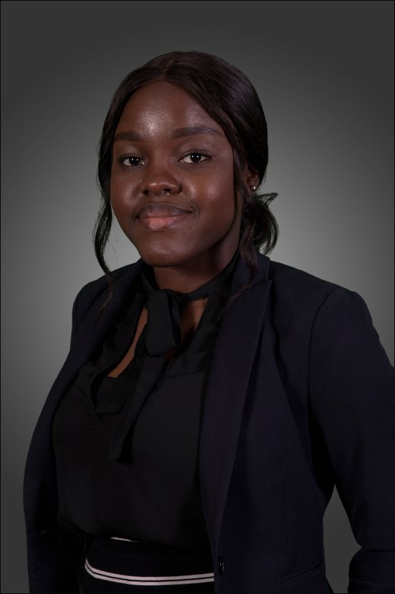
Requirements Specifications Trudy Ani-Asamani
3-4 Servo Motors – MG996R
Weight: 55g
Dimensions: 40.7 x 19.7 x42.9 mm
Operating voltage: 4.8V - 7.2V
Robot Arm (Assembled)
Resistors and breadboard for the connection of the servos
ARV Micro-controller ATMEGA328P
Operating voltage: 2.7V to 5.5V
Digital Communication Peripherals: 1-UART, 2SPI, 1-I2C

Slide 6
Requirement specifications
Raspberry Camera Module v2:
Weight: 3 grams
Size: Around 25 x 24 x 9 mm
Still resolution: 8 Megapixels
Linux integration: V4L2 driver available
Raspberry Pi 4:
28x user GPIO supporting various interface options such as UART (6x)
2x Raspberry Camera Port
Power: 5V at 3A

Slide 7
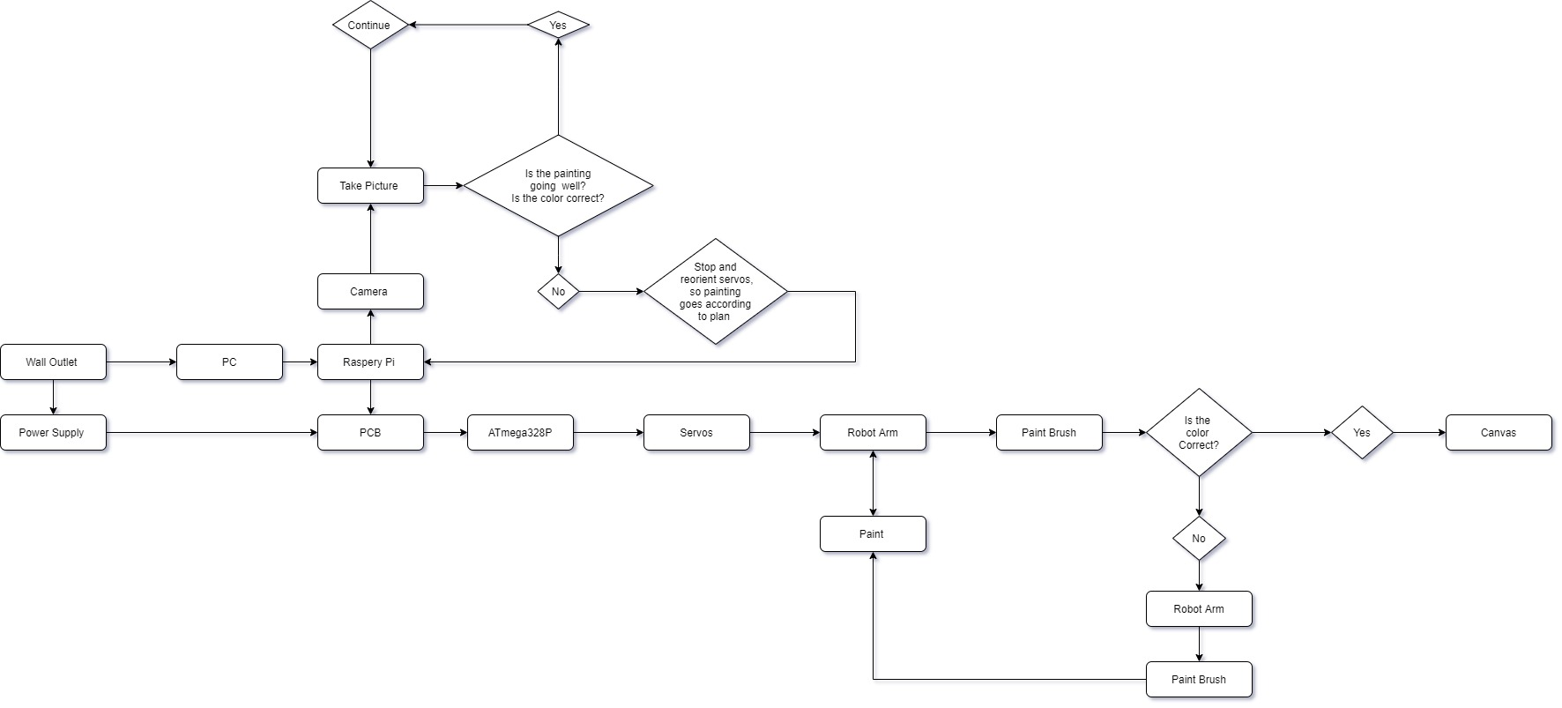
PROJECT BLOCK DIAGRAM

Slide 8
Design choices
Purchasing the robot arm frame than constructing or 3-D printing was an economic decision that reduced the mechanical engineering tasks of the project.
Microcontroller: ATmega328P (high performing compared with other microcontrollers like AT89C52, ATmega8A, etc)
Raspberry Camera Module
Servos MG996R

Slide 9
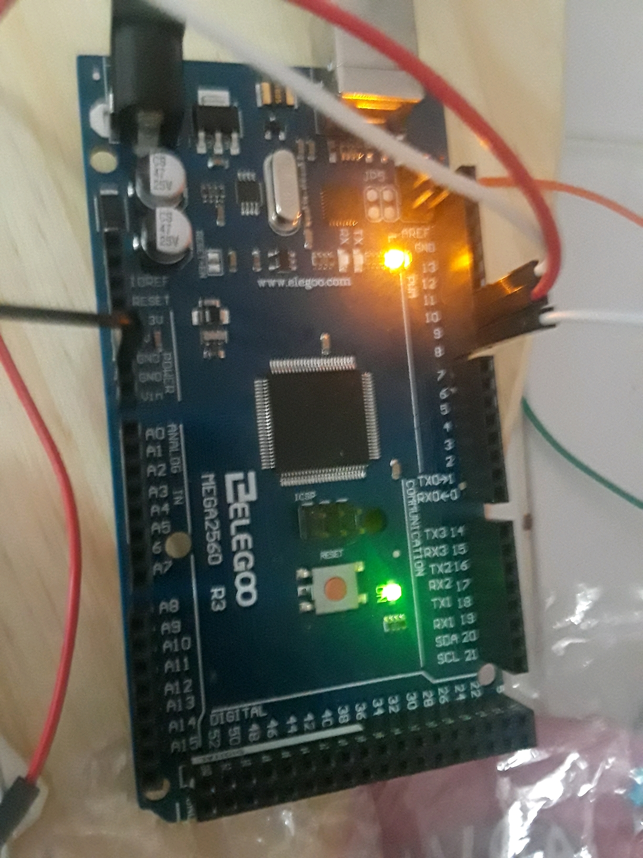
MICROCONTROLLER: ATmega328P
It has 6 pulse width modulation channels
It was the best economical choice
Digital communication peripherals (UART)
(Photo is of a ATmega2560, which is an upgraded ATmega328P)

Slide 10
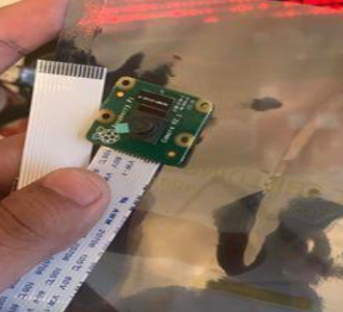
Raspberry Camera module
The small-scale size of the camera corresponds with the robot frame. If needed it can be bolted onto the robot arm without adding too much weight.
Provides best pixel resolution needed for the project.
Best economical price for our budget

Slide 11
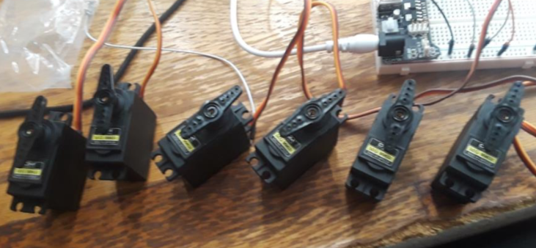
Servos MG996R
Fit the robot frame
Programmable with C++
Best economic choice for the robot frame

Slide 12
Hardware

Slide 13
pcb

Slide 14
components
ATMEGA328-2GP Microcontroller
L200 Voltage regulator
DC power jack
Raspberry PI GPIO
USB-A

Slide 15
BOARD

Slide 16
PCB
Communication between Raspberry pi camera and the servo motors
Supplying power for the entire device
USB portable to upload images onto microcontroller
Will be programmed to allow specific arm movements

Slide 17
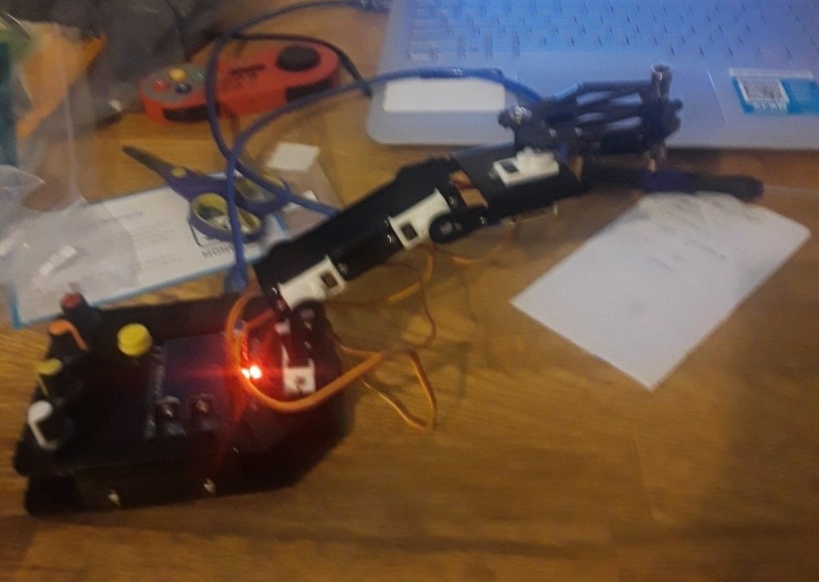
FIRST rOBOT ARM
Alan Azargushasb
The purpose of the robot arm is to paint.
First prototype was fragile and weak, the robot arm was made of a lightweight plastic that would cause the frame to warp.
The servos were too weak to use , robot would collapse in on itself over and over again.
The gripper could not maintain grip on a pencil, thus it could not fufill its purpose as a painter.

Slide 18
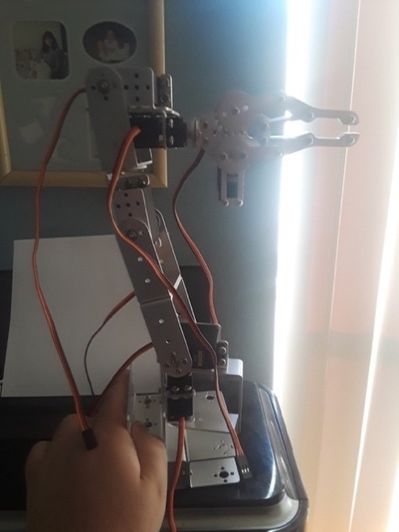
SECOND Robot arm
It has a max 5 degrees of freedom and a minimum of 3 degrees of freedom.
Each servo has about a range of motion of about 180 degrees though the second servo from the bottom has a limit of about 130 degrees due to the aluminum brace blocking the lever.
It is made of aluminum.
With all the parts it weighs about 1 pound
Hight with robot gripper is 460 millimeters.
Current design has gripper replaced with custom 3d part

Slide 19
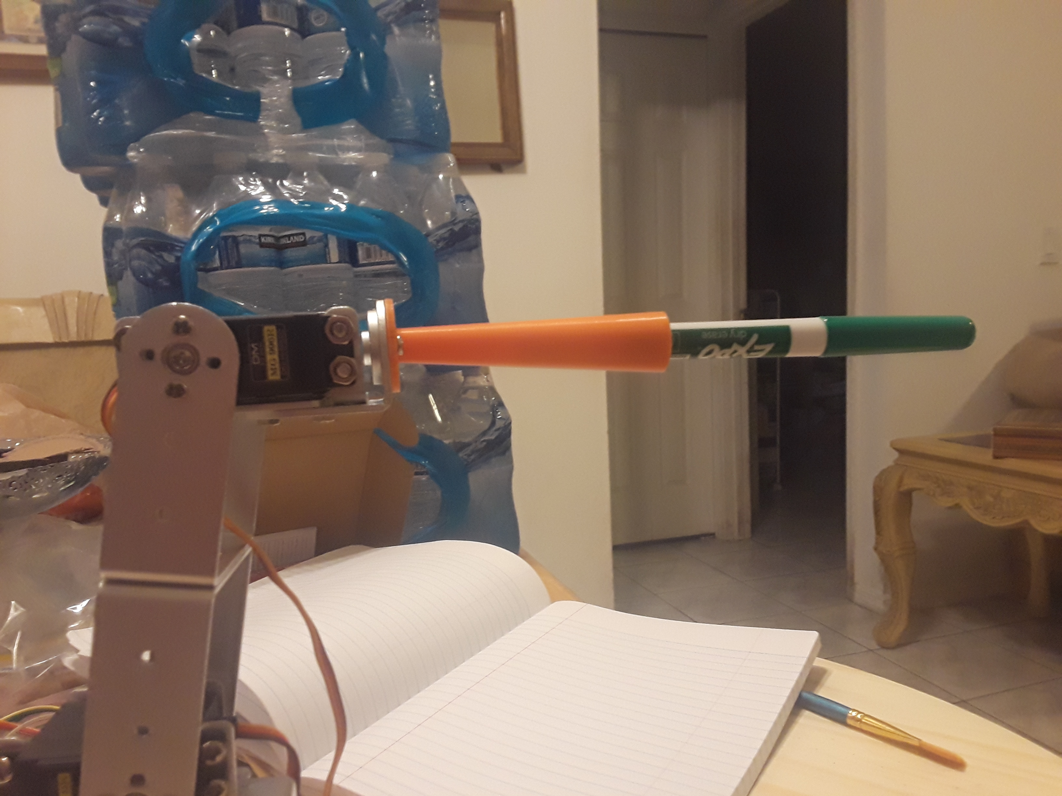
THIRD ROBOT ARM
Reduced degrees of freedom from 5 to 3.
Halved the weight.
The old design with the 3 extra servos did not add much in terms of functionality and did not justify the weight added by the servos and metal brackets.
Reduced power consumption by the dropping half the servos.
Disassembled and Reassembled the robot arm to reorient the arm from being naturally vertical to naturally horizontal.
Got rid of the metal gripper, the gripper was not a good at picking up pencils and brushes.
Now features a custom 3D printed marker attachment.
May add one of the servos back to the design, bumping it up to 4 degrees of freedom if needed.

Slide 20
Budget
Original Budget $500
So far Spent: $528.13
Things Purchased
Tools (Wrench, Hammer, Pliers)
Robot Arm
Servos (6)
Custom 3D Printed attachment
Wooden Base and Nails
Electronic Supplies
Paint Brushes and Paint
Markers and Whiteboard
Raspberry Pie and Camera (2)
Multimeter and accessories
Power Supply
MicroSD card(2)
Final Expenses Probably Under
$600

Slide 21
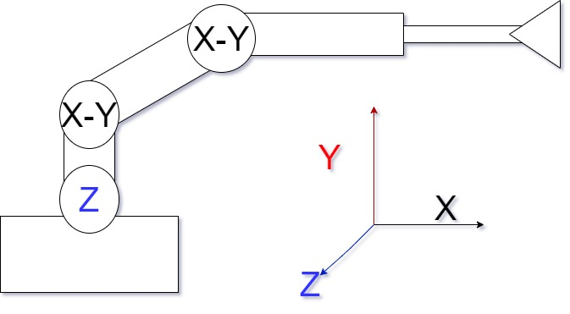
Inverse Kinematics
We currently have the 2-dimensional inverse kinematics algorithm solved and working on solving a 3d inverse kinematics algorithm.
With inverse kinematics we can simply plug in an x-y-z coordinate and the servos in the robot arm will adjust itself to reach said destination, right now we are able to plug in 2 of those 3 coordinate, x and y.
When the algorithm solves the math to adjust the servos it comes back as a decimal. The servos as far as I know only work in 1 degree integer increments, so there is inherit imprecision within the design that cannot be circumvented without getting better servos.
Currently the robot arm is set up horizontally at rest as seen in the picture to the right.

Slide 22
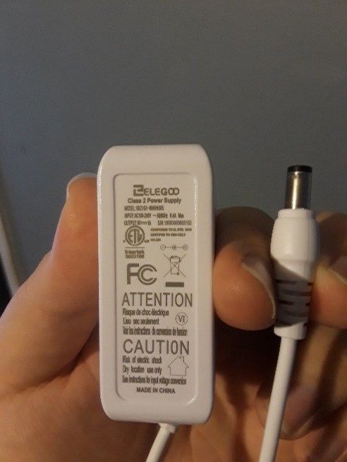
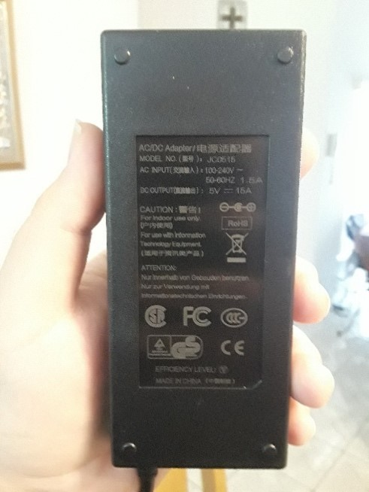
Power Supply
At the moment, we have 2 power supplies.
The first one is the white one which is rated at 9 volts 1 amp, using a voltage regulator I keep the output to 5 volts.
The second is a 5 Volts 15 Amp power supply
Having issues with the second one, so at the momentI am primarilyusing the first one.

Slide 23
Standards
Our Raspberry Pi 4 abides by the standards of IEEE 802. Thanks to IEEE 802 our Raspberry Pi can reliably connect to the internet and interface with local networks with ease.
In out project we are using USB 2.0 as a standard. We are using USB 2.0 to transfer code from the Computer to the microcontroller.
Both our power supply meets the regulations by the federal communications commission.
Our power supply has been certified by Intertek, to meet all of OSHA’s, the Occupational Safety and Health Administrations standards. The power supply has been tested in the Nationally Recognized Testing Laboratory (NRTL) and was found with the safety regulations OSHA provides. Not only that but Intertek has also certified our power supply also meets the standards for health, safety, and the environment for products in Canada. The power supply also features basic insulation.

Slide 24
Software

Slide 25
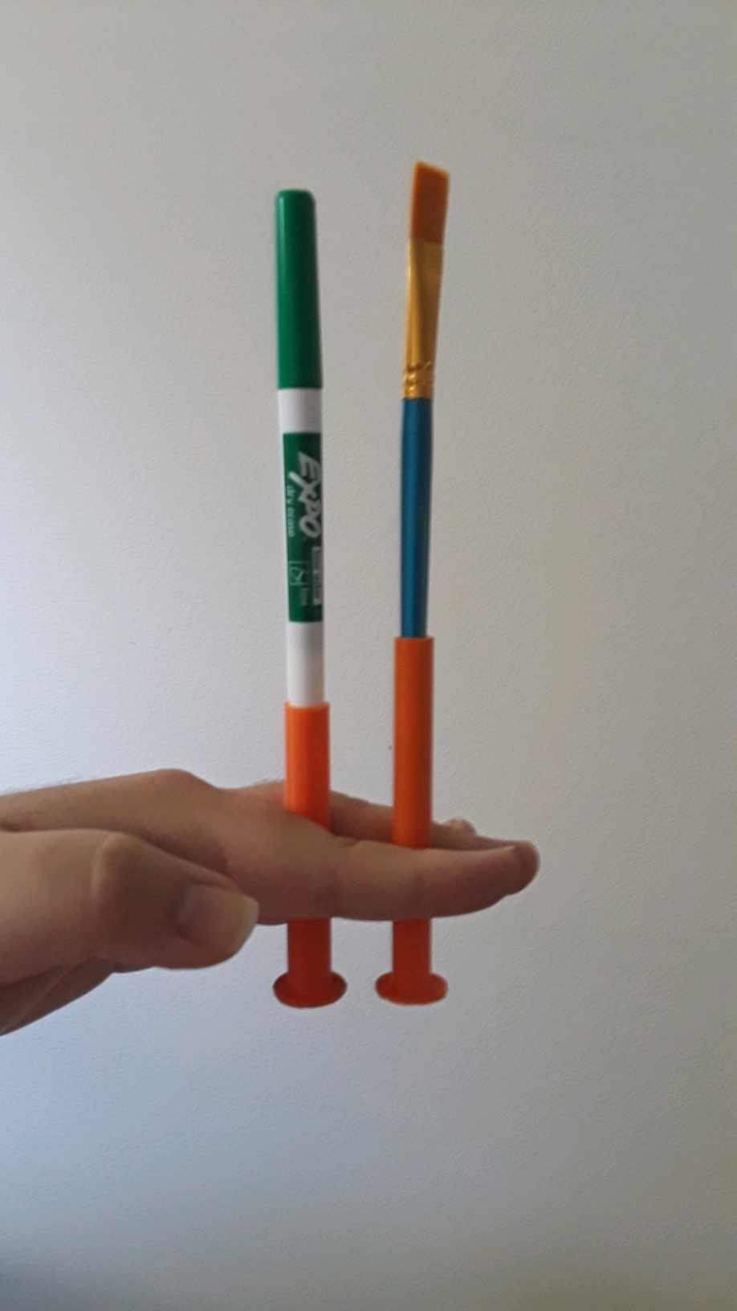
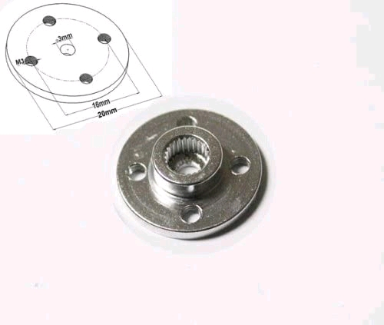
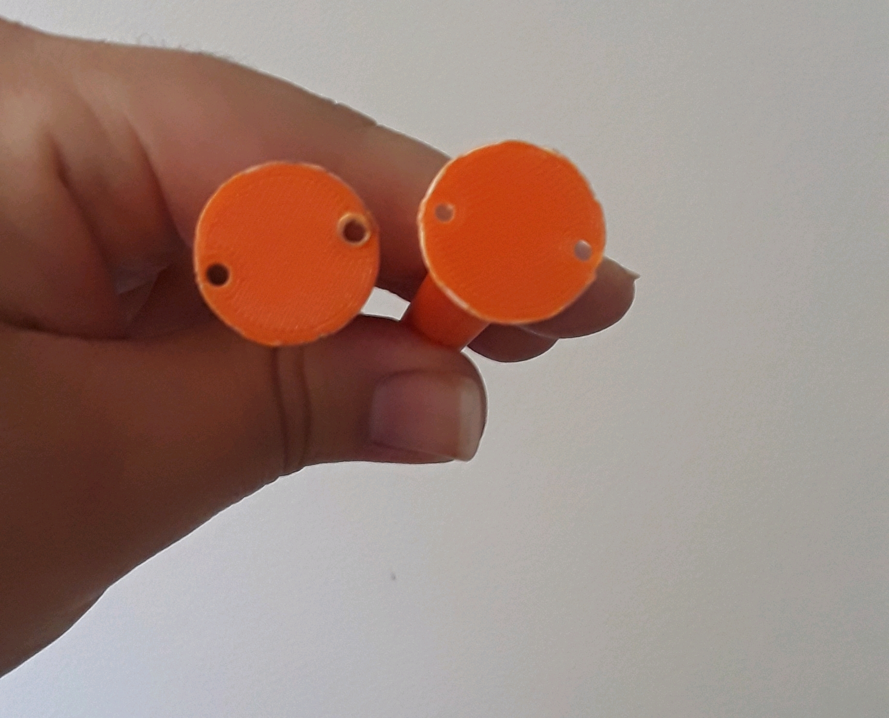
Paint brush attachment ALONSO NINALAYA
Create our unique attachment using SolidWorks
Great assistance in developing this feature was Lynda.com

Slide 26
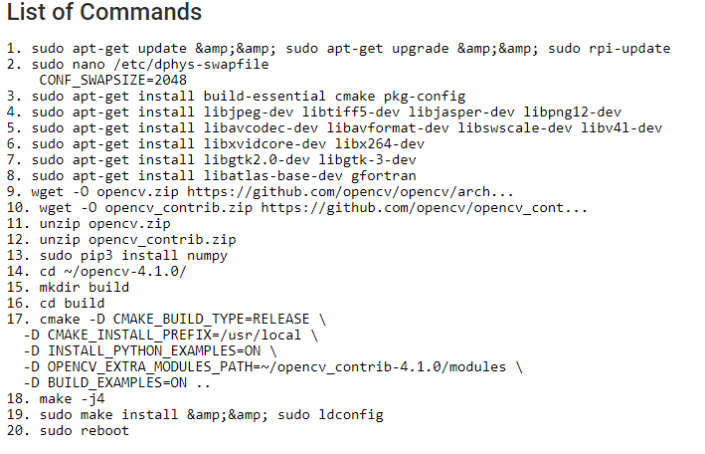
Possible slide explaining about how to set up raspberry pi
Installing python and Raspbian OS for our raspberry pi
Installing OpenCV was definitely a challenge and our list of commands will be posted in our public repository.
Other dependencies for transferring data to our ATMEGA are also needed, but these were the most relevant ones.

Slide 27
Color recognition
Decided to use HSV values rather than BGR
Purpose is to minimize the margin of error for each color detected.
This can be improved by investing more money on a better camera

Slide 28
UML DESign color recognition

Slide 29
CONTROLLING SERVOS
Preset the servos to the initial position of 90 degrees. Since
Uses C to control the servo motors
Attach pins to the corresponding servos

Slide 30
Data flow 1

Slide 31
Data flow 2

Slide 32
Development environments
Raspberry Pi 4: Python3 and OpenCV
ARV micro-controller: C ++
UART: Both are using their respective language
Operating System: Ubuntu Linux
Integration Development Environment (IDE): Nano

Slide 33
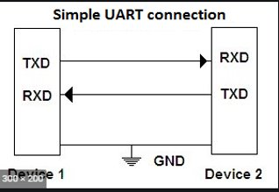
UaRT CONNECTION
Equal Baud Rate
Our Data packet must be 8-bits long

Slide 34
USER INTERFACE PROCESS
EXPLAIN HOW ANOTHER USER CAN USE OUR SOFTWARE
Our project can be found in our public repository posted at the resources of this PowerPoint. It can be cloned locally and run using a raspberry Pi. You can also find a list of everything we used to set up the environments in the README.md file.

Slide 35
TEST CASES
Try to make the robot paint in black and white (UART)
Array of points to see how well the robot arm follows instruction (SERVOS, UART)
Paint a specific color from an uploaded picture (color recognition)

Slide 36
IMPLEMENTATION CHALLENGES
Learn SolidWorks and find a company who wanted to print it. Since the part was small, not many companies wanted to do it.
Figure out how to interface the microcontroller with the raspberry pi
Solving the algorithm for inverse kinematics
Disassembling and reassembling the robot arm to make the robot arm compatible with the inverse kinematics.
Printing the board when all the PCB printing companies are backed up.

Slide 37
Project roles
Task | Primary | Secondary | Status
Microcontroller Interface | Alonso | Chedlyne | In development
PCB | Chedlyne | Trudy | In development
Camera | Alonso | Trudy | In development
Assembling parts | Alan |  | In development
Testing and Calibrating Servo motors | Alan
Paint brush attachment | Alonso | Alan | In development
Power Supply | Trudy |  | In development

